Slide 1
TASK 1
SCREENSHOTS OF SOLVED PORTSWIGGER LABS

Slide 2
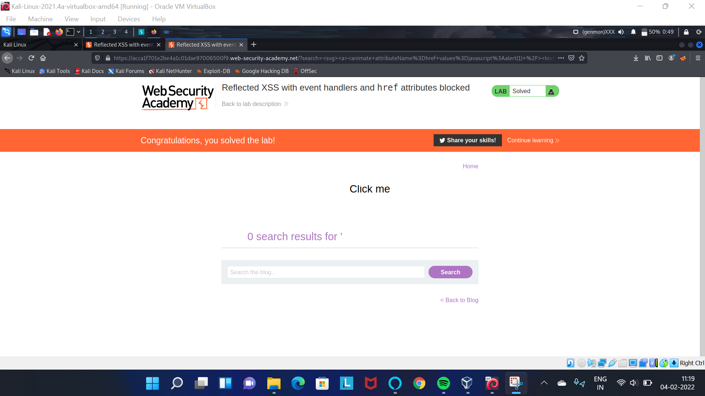

Slide 3
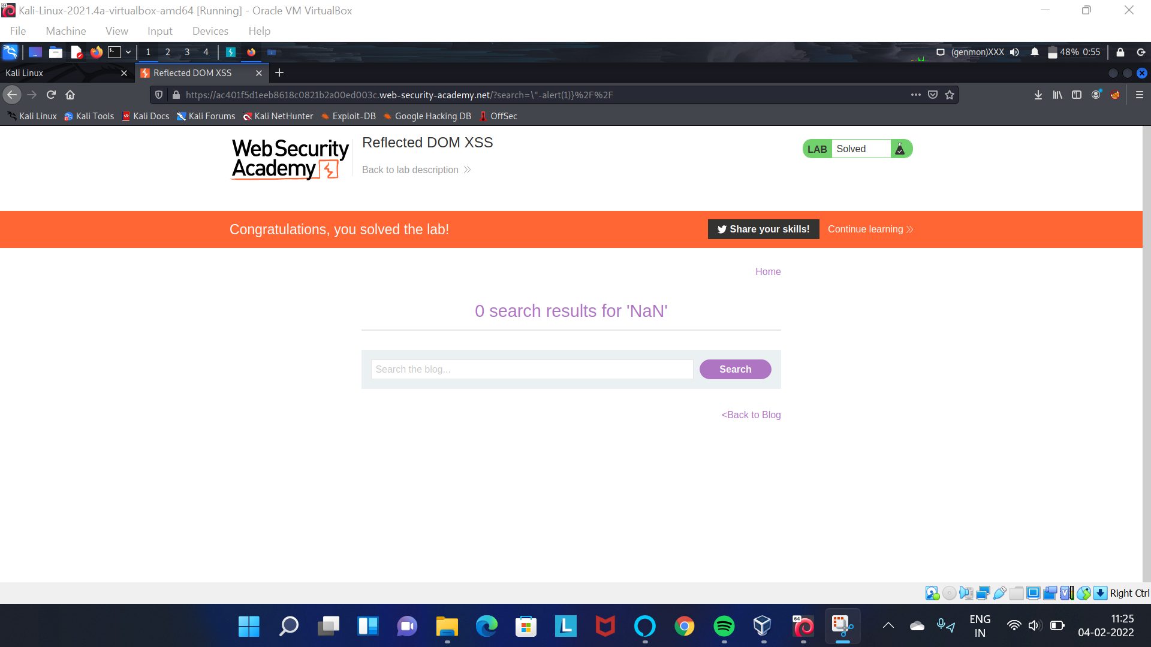

Slide 4
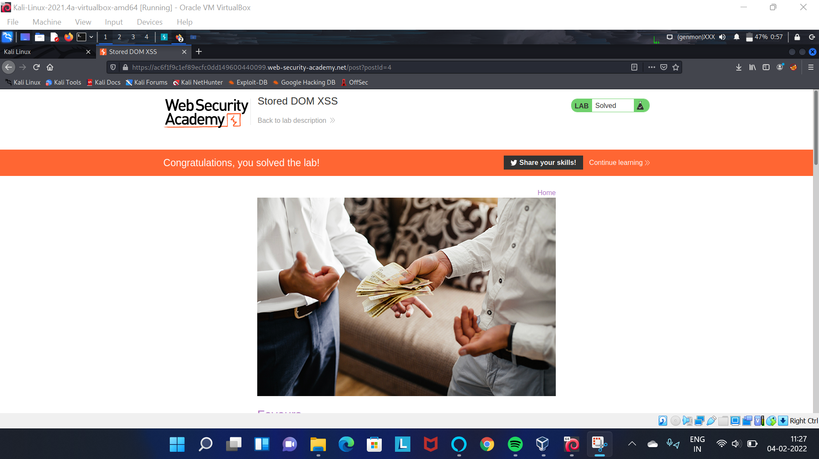

Slide 5


Slide 6
